Slide 1
SSTC31269: Business Requirements Modelling
Week 2 Seminar – “Requirements Process”
References:
Mastering The Requirements Process, Chapter 2
BABOK Guide version 3.0, Chapters 1 and 2

Slide 2
Objectives
Understand “Requirements Process” within the system development process.
Understand the stages/phases of a Requirements Process and activities and tasks within each stage/phase.
Identify Stakeholders and understand who they are.

Slide 3
Topics
System Development Process
Requirements Process
Requirements Elicitation: Stakeholders Analysis
Types of Requirements
Functional requirements
Non-functional requirements

Slide 4
Waterfall System Development Process
Requirements Engineering (Upfront Detailed Requirements)
The “Waterfall” Model (Royce, 1970)
System & Software Design
Build Software Components & Test
Integration & System Testing
Operation & Maintenance
Notes:
The waterfall model is a sequential design process, used in software development processes, in which progress is seen as flowing steadily downwards (like a waterfall) through the phases of Conception, Initiation, Analysis, Design, Construction, Testing, Production/Implementation and Maintenance.
http://en.wikipedia.org/wiki/Waterfall_model
http://en.wikipedia.org/wiki/Software_development_process
The waterfall model maintains that one should move to another phase only when its preceding phase is reviewed and verified. One phase is completed in its entirety before moving on to the next phase. And you rarely revisit a phase once it is completed.

Slide 5
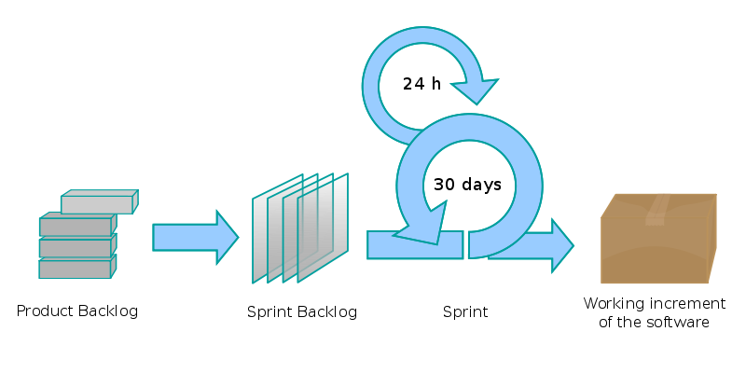
Agile System Development Process
Scrum – Iterative Process
Initial Requirements or User Stories
Detail Requirements or User Stories
Subset/portion of requirements
Please watch the video available on uts online – “Intro to Agile Scrum in Under 10 Minutes”
Source: http://en.wikipedia.org/wiki/Scrum_(development)
Notes:
Agile software development is a group of software development methods in which requirements and solutions evolve through collaboration between self-organizing, cross-functional teams. It promotes adaptive planning, evolutionary development, early delivery, continuous improvement and encourages rapid and flexible response to change. It is a conceptual framework that focuses on delivering working software with the minimum amount of work. http://en.wikipedia.org/wiki/Agile_software_development
Scrum is an iterative and incremental agile software development framework for managing product development. It defines "a flexible, holistic product development strategy where a development team works as a unit to reach a common goal", challenges assumptions of the "traditional, sequential approach" to product development.
A key principle of Scrum is its recognition that during a project the customers can change their minds about what they want and need (often called "requirements churn"), and that unpredicted challenges cannot be easily addressed in a traditional predictive or planned manner.
Sprint
The Scrum process
A sprint (or iteration) is the basic unit of development in Scrum. The sprint is a "timeboxed" effort; that is, it is restricted to a specific duration. The duration is fixed in advance for each sprint and is normally between one week and one month, although two weeks is typical.
Each sprint is started by a planning meeting, where the tasks for the sprint are identified and an estimated commitment for the sprint goal is made, and ended by a sprint review-and-retrospective meeting, where the progress is reviewed and lessons for the next sprint are identified.
Iterative and incremental development (http://en.wikipedia.org/wiki/Iterative_and_incremental_development)
The basic idea behind this method is to develop a system through repeated cycles (iterative) and in smaller portions at a time (incremental), allowing software developers to take advantage of what was learned during development of earlier parts or versions of the system. Learning comes from both the development and use of the system, where possible key steps in the process start with a simple implementation of a subset of the software requirements and iteratively enhance the evolving versions until the full system is implemented.
Incremental development slices the system functionality into increments (portions). In each increment, a slice of functionality is delivered through cross-discipline work, from the requirements to the deployment.

Slide 6
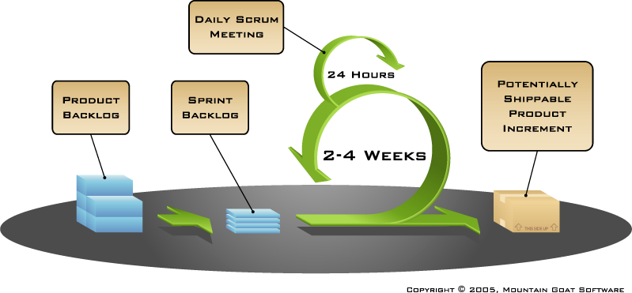
SCRUM at a glance

Slide 7
Iterative and incremental development
The basic idea behind this method is to develop a system through repeated cycles (iterative) and in smaller portions at a time (incremental), allowing software developers to take advantage of what was learned during development of earlier parts or versions of the system.
Learning comes from both the development and use of the system, where possible key steps in the process start with a simple implementation of a subset of the software requirements and iteratively enhance the evolving versions until the full system is implemented.
Incremental development slices the system functionality into increments (portions). In each increment, a slice of functionality is delivered through cross-discipline work, from the requirements to the deployment.
(http://en.wikipedia.org/wiki/Iterative_and_incremental_development)

Slide 8


Sequential (traditional approach) vs. overlapping (agile) development
Requirements
Design
Code
Test
Rather than doing all of one thing (phase) at a time...
...Scrum teams do a little of everything all the time
Source: “The New New Product Development Game” by Takeuchi and Nonaka. Harvard Business Review, January 1986.

Slide 9
Sprints
A sprint (or iteration) is the basic unit of development in Scrum. Scrum projects make progress in a series of “sprints”.
Analogous to Extreme Programming iterations
Typical duration is 2–4 weeks or a calendar month at most
A constant duration leads to a better rhythm.
Product is designed, coded, and tested during the sprint.
Each sprint starts with a sprint planning event, the aim of which is to define a sprint backlog, where the work for the sprint is identified and an estimated commitment for the sprint goal is made.
Each sprint ends with a sprint review and a sprint retrospective, where the progress is reviewed and lessons for the next sprint are identified.

Slide 10
Scrum Framework
Roles
Product owner
ScrumMaster
Team
Ceremonies
Sprint planning
Sprint review
Sprint retrospective
Daily scrum meeting
Artifacts
Product backlog
Sprint backlog
Burndown charts

Slide 11
Scrum Framework
Roles
Product owner
ScrumMaster
Team
Ceremonies
Sprint planning
Sprint review
Sprint retrospective
Daily scrum meeting
Artifacts
Product backlog
Sprint backlog
Burndown charts

Slide 12

Product owner
Represents the stakeholders and is the voice of the customer and is accountable for ensuring that the team delivers value to the business.
Writes (or has the team write) customer-centric items (typically user stories), ranks and prioritizes them, and adds them to the product backlog.
Defines the features of the product.
Decides on release date and content.
Responsible for the profitability of the product (ROI).
Prioritizes features according to market value in the Product Backlog Items.
Adjusts features and priority every iteration, as needed.
Accepts or rejects work results.

Slide 13

The ScrumMaster
Is a Facilitator.
Represents management to the project.
Responsible for enacting Scrum values and practices.
Removes impediments.
Ensure that the team is fully functional and productive.
Enables close cooperation across all roles and functions.
Shields the team from external interferences.

Slide 14





The Team
Typically 5-9 people
Cross-functional:
Programmers, testers, user experience designers, etc.
The development team is responsible for delivering potentially shippable increments (PSIs) of product at the end of each sprint (the sprint goal).
Teams are self-organizing
Ideally, no titles but rarely a possibility
Membership should change only between sprints

Slide 15
Requirements Engineering/Development Process
To find the correct and complete requirements, we need some kind of orderly process. And hence we need Requirements Process.
Process is a set of steps (phases) that a software program goes through when developed.
It is a structure imposed on the development of a software product.

Slide 16
Requirements Engineering/Development Process
Negotiation, Prioritising & Management
Planning & Elicitation
Modelling & Analysis
Specification & Documentation
Validation & Inspection

Slide 17
Requirements Process
Requirements process includes:
stages/phases (e.g. Planning, Analysis, Elicitation, Specification, etc.)
activities and tasks (within each stage/phase)
techniques
tools
for discovering the purpose of the “software”, and the needs of the users to support their activities.

Slide 18
Requirements Process
Requirements process includes:
identifying stakeholders
Identifying their needs
documenting these needs/requirements in the form of a model that is amenable to
analysis
communication
subsequent implementation (creating software)

Slide 19
Requirements Engineering
Software system development is driven by
“Requirements Engineering”
Requirements engineering (RE) refers to the process of defining, documenting and maintaining requirements and to the subfields of systems engineering and software engineering concerned with this process. http://en.wikipedia.org/wiki/Requirements_engineering

Slide 20
Requirements Process Stages: Requirements Elicitation
Process of seeking, uncovering, acquiring, and elaborating requirements for computer-based systems.
Requirements are elicited rather than just captured or collected. This implies there are discovery, emergence, and development elements to the elicitation process.
A complex process involving many activities with a variety of available techniques, approaches, and tools.
We need to identify the various sources of requirements. Hence we need to identify and analyse all the relevant stakeholders.
Notes:
More details to follow in the seminar next week on Requirements Elicitation

Slide 21
Requirements Elicitation Techniques
Brain Storming
Interviews
Requirements Workshops
Document Analysis
Observation
Prototyping
Survey questionnaires
Note: More details about these techniques in next week’s seminar on Requirements Elicitation

Slide 22
Requirements Process Stages: Requirements Analysis & Modelling
Requirements Analysis: determining whether the stated requirements are clear, complete, consistent and unambiguous, and resolving any apparent conflicts.
Requirements Modelling: developing a set of diagrams known as requirements models, each of which focuses on a different aspect of the users' needs. e.g.
Business Process Modelling with BPMN
Data Modelling with ERD
Object Oriented Modelling with UML

Slide 23
Requirements Process Stages: Requirements Specification & Requirements Validation
Requirements Specification: After analysing and modelling the requirements, requirements are specified and documented in a software requirements specification (SRS) document.
Requirements Verification and Validation: checking that the documented requirements and models are consistent and meet stakeholder needs.

Slide 24
Requirements Process Stages: Requirements Management
Requirements Management is the process of documenting, analyzing, tracing, prioritizing and agreeing on requirements and then controlling change and communicating to relevant stakeholders.
It is a continuous process throughout a project.
The purpose of requirements management is to ensure that an organisation documents, verifies, and meets the needs and expectations of its customers and internal or external stakeholders.
Notes:
http://en.wikipedia.org/wiki/Requirements_management

Slide 25
Requirements Process Stages: Requirements Management
Requirements Management Tools
Requirements Backlog
Burndown charts
Requirements Register or Excel Spreadsheet
IBM JazzHub
JIRA
Notes:
http://en.wikipedia.org/wiki/Requirements_management

Slide 26
Requirements Quality
Requirements are SMART
Specific, Simple
Measureable, Manageable
Attainable (Achievable, Actionable, Appropriate)
Realistic (Rationale, Result Oriented, Realistic to deliver)
Time-bound (Timely, Testable, Traceable)
More details in workshop notes. Also, please refer notes section of this slide. Go to this link and read the examples: https://www.slideshare.net/HarmonyBrenner/smart-requirements-4590952
Notes:
So what makes a good requirement? There is a commonly used acronym (SMART) that is used to remember and guide requirements development. Specific: a good requirement is specific and not generic. It should be clearly defined an not be open to mis-interpretation when read by others.
Measurable: this answers whether you will be able to verify the completion of the project and that requirement. You should avoid signing up for any requirement that cannot be verified as complete.
Attainable: also referred to as achievable, actionable, or appropriate. All are fine attributes and are intended to ensure that the requirement is physically able to be achieved given existing circumstances.
Realistic: answers whether the requirement is realistic to deliver when considering other constraints of the project and requirements. Are the requirements and other project constraints in their entirety, able to be met? Do you have the budget and time to complete. Does the team have the knowledge to complete on time?
Time-bound (timely, traceable): where appropriate each requirement should be time-bound or specify by when or how fast a requirement needs to be completed or executed. Also whether a requirement is traceable?

Slide 27
Types of Requirements
Functional Requirements (things product must do)
Examples:
The software system should be able to produce a monthly sales report for a given month…
The system shall enable hotel guests to book a room online.
Non-functional Requirements (qualities product must have)
Examples:
The software system should be able to produce a monthly sales report for a given month in less than 5 seconds…
The software system should be able to produce a monthly sales report for a given month in less than 5 seconds and display it on iPad…
The system shall be able to process 100 payment transactions per second.

Slide 28
Types of Requirements
Functional Requirements (things product/system must do)
describe the behavior and information that the solution will manage.
They describe capabilities the system will be able to perform in terms of behaviors or operations—specific information technology application actions or responses.
Non-functional Requirements (qualities product/system must have)
capture conditions that do not directly relate to the behavior or functionality of the solution, but rather describe environmental conditions under which the solution must remain effective or qualities that the systems must have.
They are also known as quality or supplementary requirements. These can include requirements related to capacity, speed, safety, security, availability and the information architecture and presentation of the user interface. Examples include software performance requirements, external interface requirements, software design constraints and software quality attributes.
Notes:
More details about this topic in Week 6 Seminar
Functional Requirements: are things the product must do
Non-functional Requirements: are properties, or qualities the product must have if it is to be acceptable to its owner and operator.
Below are some references and additional resources
Non-Functional Requirements: http://users.csc.calpoly.edu/~jdalbey/SWE/QA/nonfunctional.html http://users.csc.calpoly.edu/~jdalbey/SWE/QA/nonfunctionalExamples.html

Slide 29
Requirements Activities/Tasks
Requirements are
Identified
Captured
Managed
Communicated
Prioritised
Estimated
Scoped
De-scoped
Signed Off

Slide 30
Requirements Process
Negotiation, Prioritising & Management
Planning & Elicitation
Modelling & Analysis
Specification & Documentation
Validation & Inspection

Slide 31
Requirements Elicitation: Stakeholders Analysis Who are Stakeholders?
Stakeholders
An individual, team or organisation who have interest in, or can influence or be affected by, or participate in the development of requirements and relative software system projects
Stakeholder have different roles based on their interest and responsibility in an organisation
Failure to discover all stakeholders can mean failure to discover all their needs.
Find all parties who will be affected by the product, and find their requirements/needs.

Slide 32
Stakeholder Classes/Types/Roles
Sponsor
Owner
Project Manager
Business Analyst (BA) – our role
Quality Analyst
Customer
Supplier
End User
Domain Subject Matter Expert (SME)
Implementation Subject Matter Expert (SME)
Support Professionals
Regulator

Slide 33
Stakeholder Classes: roles
Users: Users have an interest in having a product that does their work correctly. They are people who will ultimately be hands on operators of your product.
Sponsor: Sponsor is an owner representative and represents owner’s interest. Pays for the development of the product. For e.g., Departmental Manager, Program Manager, etc.
Subject Matter Experts: People who have specialised knowledge of the business subject, individual with in-depth knowledge of a topic relevant to the business need or solution scope
Notes:
Failure to discover all stakeholders can mean failure to discover all their needs. Find all parties who will be affected by the product, and find their requirements/needs.
For more details see BABOK Guide Chapter2.

Slide 34
Stakeholder Classes: roles
Customer: The customer buys the product once it is developed. A customer is a stakeholder outside the boundary of a given organization or organizational unit. Know this person well to understand what he/she finds valuable and what appeals to them.
Developers/Software Engineers: Developers are responsible for the construction of software applications. Areas of expertise among developers or software engineers include particular languages or application components.
Project Manager: Project managers are responsible for managing the work required to deliver a solution that meets a business need, and for ensuring that the project’s objectives are met while balancing the project constraints, including scope, budget, schedule, resources, quality, risk, and others.
Note: For more details see BABOK Guide Chapter2.
Notes:
Failure to discover all stakeholders can mean failure to discover all their needs. Find all parties who will be affected by the product, and find their requirements/needs.
For more details see BABOK Guide Chapter1.

Slide 35
Requirements Elicitation: Stakeholders Analysis Identifying and understanding stakeholders
Below are some questions to consider when identifying the stakholders and analysing the impact of new changes.
Who is the new change and business transformation going to affect (who all will be impacted?)?
Who has an interest in these new changes and this project?
Who and how are you going to communicate these changes/requirements to the stakeholders? What is the communications plan?
Who are critical to this business transformation? Who can influence?
Who is paying for the project?
Who will be managing, reviewing and signing off?
Note: Please watch “Workshop Videos 1 and 2” available on uts online to identify and understand the stakeholders.
Stakeholders analysis/identification techniques:
Technique1: stakeholders list/map/register and
Technique2: empathy map
Notes:
Google “Stakeholders table” or “Stakeholders map” or “Stakeholders register” to see examples
Let’s now get started with Requirements Elicitation phase and look at Stakeholders Identification and Analysis within the elicitation phase. We need to identify the various sources of requirements. Hence we need to identify and analyse all the relevant stakeholders.

Slide 36
Stakeholders Analysis: Why do it?
Stakeholder analysis involves identifying all the relevant stakeholders and eliciting and understanding their needs (and any issues with current system).
Stakeholder analysis is the review and consideration of the impact stakeholders have on your business. Companies need to understand the interests of each stakeholder.
To understand the importance and influence of individual stakeholders on the project.
To utilise the vast amount of information and knowledge that stakeholders hold to find workable, efficient and sustainable solutions.
To Gain support from powerful stakeholders which can help you to win more resources – this makes it more likely that your projects will have less obstacles and conflicts and hence be successful.

Slide 37
Stakeholders Analysis and Identification Technique 1: Stakeholders Map/Register/Table
 | Position | Project Role | Contact Information | Level of Interest | Level of Influence | Potential Management Strategies
Mike Sundby | VP of HR | Project Champion | msundy@globalconstruction.com | High | High | Mike is very outgoing and visionary. Great traits for a project champion. He is concerned about financials and has an MBA. Keep him informed and ask for his advice as needed.
Lucy Camerena | Training Director | Project Sponsor | lcamerena@globalconstruction.com | High | High | Lucy has a PhD in Education and knows training at this company. She is very professional and easy to work with, but she can stretch out conversations. Make sure she reviews important work before showing it to other managers.
Ron Ryan | Senior HR staff member | Led the Phase I project | rryan@globalconstruction.com | Medium | Medium | Ron led the phase I project and is upset that he was not asked to lead this phase II project. He's been with the company for over 20 years and can be a good resource but he can also sabotage the project. Ask Lucy to talk to him to avoid problems. Perhaps give him a small consulting role on the project.
Xxx Yyyy
Yyy Zzz
Could be high, medium or low
Note: This document should not be circulated to every team member as it contains sensitive information.
Source: https://www.youtube.com/watch?v=BkUCcJwwvAQ&t=373s
Notes:
Google “Stakeholders table” or “Stakeholders map” or “Stakeholders register” to see examples
Also, you can refer pages 344 and 345 of BABOK Guide version 3.

Slide 38
Stakeholders Analysis and Identification Technique 2: Empathy Map
An empathy map is a collaborative tool teams can use to gain a deeper insight into their customers. It is used to understand what is it that motivates the client (or a particular key stakeholder).
Empathy Mapping helps us consider how other people are thinking and feeling (about this business transformation or new system/process). An empathy map is a collaborative tool that puts us in the shoes of our clients.
An empathy map consists of a simple face surrounded by six sections:
1. Think & Feel 2. Hear 3. See 4. Say & Do 5. Pain 6. Gain
Empathy maps can be used whenever you find a need to immerse yourself in a user’s environment and try to understand as to what does that user/stakeholder think about the new system.

Slide 39
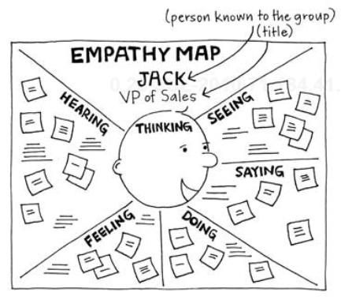
Stakeholders Analysis and Identification Technique 2: Empathy Map
Source: http://www.cooper.com/journal/2014/05/persona-empathy-mapping

Slide 40
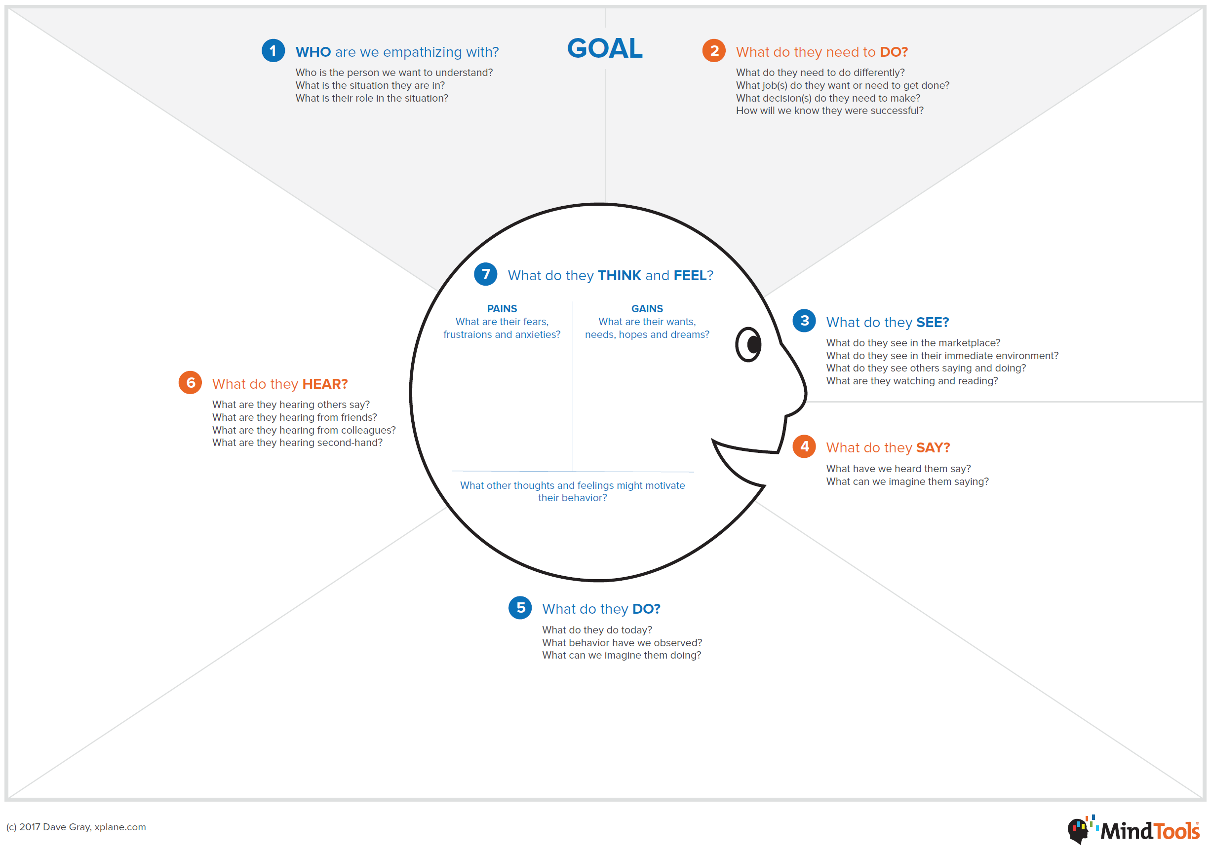
Stakeholders Analysis and Identification Technique 2: Empathy Map
Source: https://www.mindtools.com/pages/article/empathy-mapping.htm
Notes:
Empathy Mapping was developed by Dave Gray, co-founder of strategy consultants XPlane. It's a powerful visualization tool designed to help teams use Emotional Intelligence to gain insight into a target group.
The tool provides a series of prompts to identify a target group's thoughts, feelings, motivations, desires, and needs . This forces the investigating team to focus on the target group's requirements, rather than its own.
A product development team, for instance, could use an Empathy Map to consider how people might respond to a new device or a pain point. A team manager might use one to assess his or her team's reaction to a new workflow.
Source: https://www.mindtools.com/pages/article/empathy-mapping.htm

Slide 41
What do we want from users?
What?
Understand their problems – what is limiting them?
Understand the requirements of the current and future system
Understand the scope
Understand the requirements priority

Slide 42
Conflicts and Challenges
Why are there conflicts?
Empires, power and fear
Why are there differences between stakeholders?
Different views, time-frames, granularity, experiences
What influences these differences?
Communication, Openness
Notes:
Stories of conflict… it’s all conflict all the time, business as usual
A conflict may result from stakeholders in different areas viewing requirements from different perspectives. It may also result from conflicting priorities.
Facilitate communication between the stakeholders who are in conflict over the requirement in order to resolve the issue. Conflicts may be resolved through formal meetings among affected stakeholders, through research, resolution by a third party, or other methods as appropriate. Conflicts that affect the requirements must be resolved before formal approval is given to those requirements.
Source: BABOK guide

Slide 43
Understanding Conflicts
Stakeholders may have differing or conflicting requirements
Not understanding stakeholder differences can lead to
Poor communication
Miscommunication
Conflicts and failed software projects
Unless there is an understanding of what causes the conflicts, it is very difficult to determine appropriate trade-offs
Facilitate communication between the stakeholders who are in conflict over the requirement in order to resolve the issue.
Conflicts may be resolved through formal meetings among affected stakeholders, through research, resolution by a third party, or other methods as appropriate.
Source: BABOK guide

Slide 44
Summary
System Development Process
Requirements Process
Stakeholders Analysis
Take Away Message
You need to have sufficient understanding of “what” to build before figuring out exactly “how” to build it…
You need to identify all relevant stakeholders and communicate with them to learn what to build.

